Slide 1
Discriminant sparse dictionary learning based on Fisher’s ratio
Università Cattolica del Sacro Cuore
Faculties of Economics and Mathematical, Physical and Natural Sciences
Master program in Data Analytics for Business
Supervisor:
Jianyi Lin
Thesis by:
Andrea Tuscano
Academic year: 2022/2023

Slide 2
Outline
Sparse models
Discriminant dictionary learning
Classification: FD-UDL algorithm
Novel model
Research questions
Experiments
Synthetic data clustering
Image recognition
Support count classification
Conclusions

Slide 3
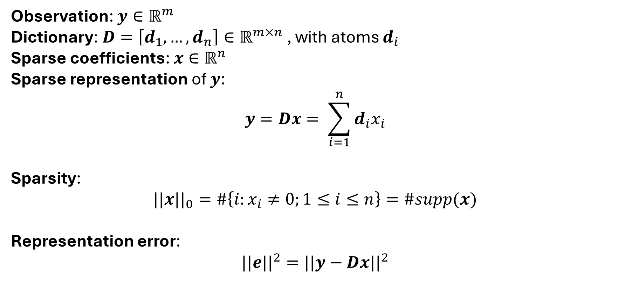
Sparse models
Observation: $y∈ℝ^{m}$
Dictionary: $D=\left[d_{1},…,d_{n}\right]∈ℝ^{m×n}$ , with atoms $d_{i}$
Sparse coefficients: $x∈ℝ^{n}$
Sparse representation of $y$:
$$y=Dx= \sum_{i=1}^{n}{d_{i}x_{i}}$$
Sparsity:
$$||x{||}_{0}=\#\left\{i:x_{i}≠0;1≤i≤n\right\}=\#supp(x)$$
Representation error:
$$||e{||}^{2}=||y−Dx{||}^{2}$$

Slide 4
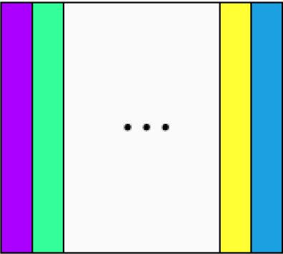
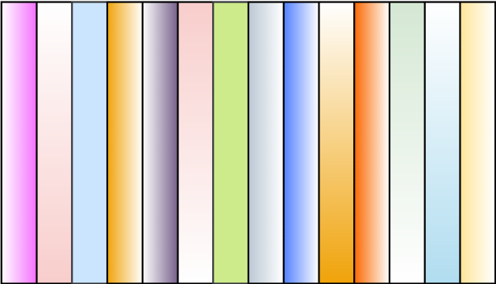
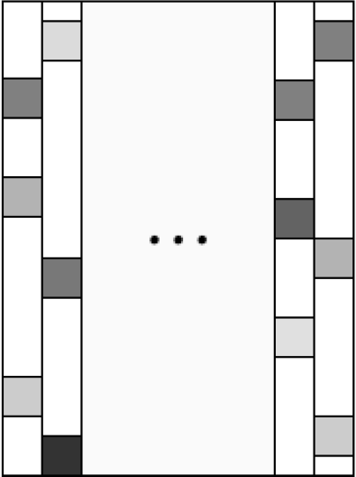

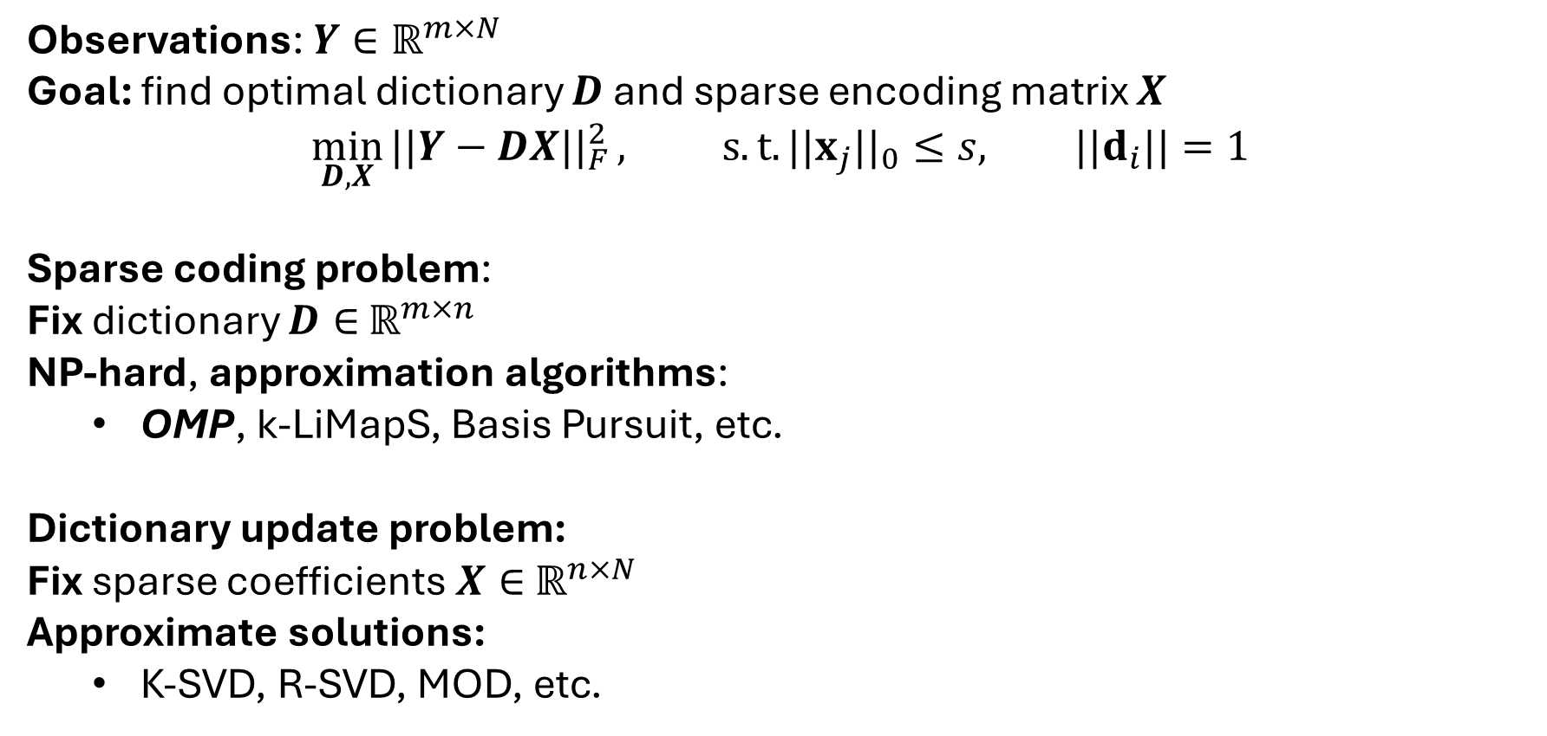

Discriminant dictionary learning
Observations: $Y∈ℝ^{m×N}$
Goal: find optimal dictionary $D$ and sparse encoding matrix $X$
$$\min_{D, X}{||Y−DX{||}_{F}^{2}}, s.t. ||x_{j}{||}_{0}≤s, ||d_{i}||=1$$
Sparse coding problem:
Fix dictionary $D∈$ $ℝ^{m×n}$
NP-hard, approximation algorithms:
OMP, k-LiMapS, Basis Pursuit, etc.
Dictionary update problem:
Fix sparse coefficients $X∈$ $ℝ^{n×N}$
Approximate solutions:
K-SVD, R-SVD, MOD, etc.
DL alternating optimization:
Repeat until convergence:
Sparse coding
Dictionary update
Return learned dictionary $D$
$y_{1},…,y_{N}$ $D$ $x_{1},…,x_{N}$
$$≈$$

Slide 5
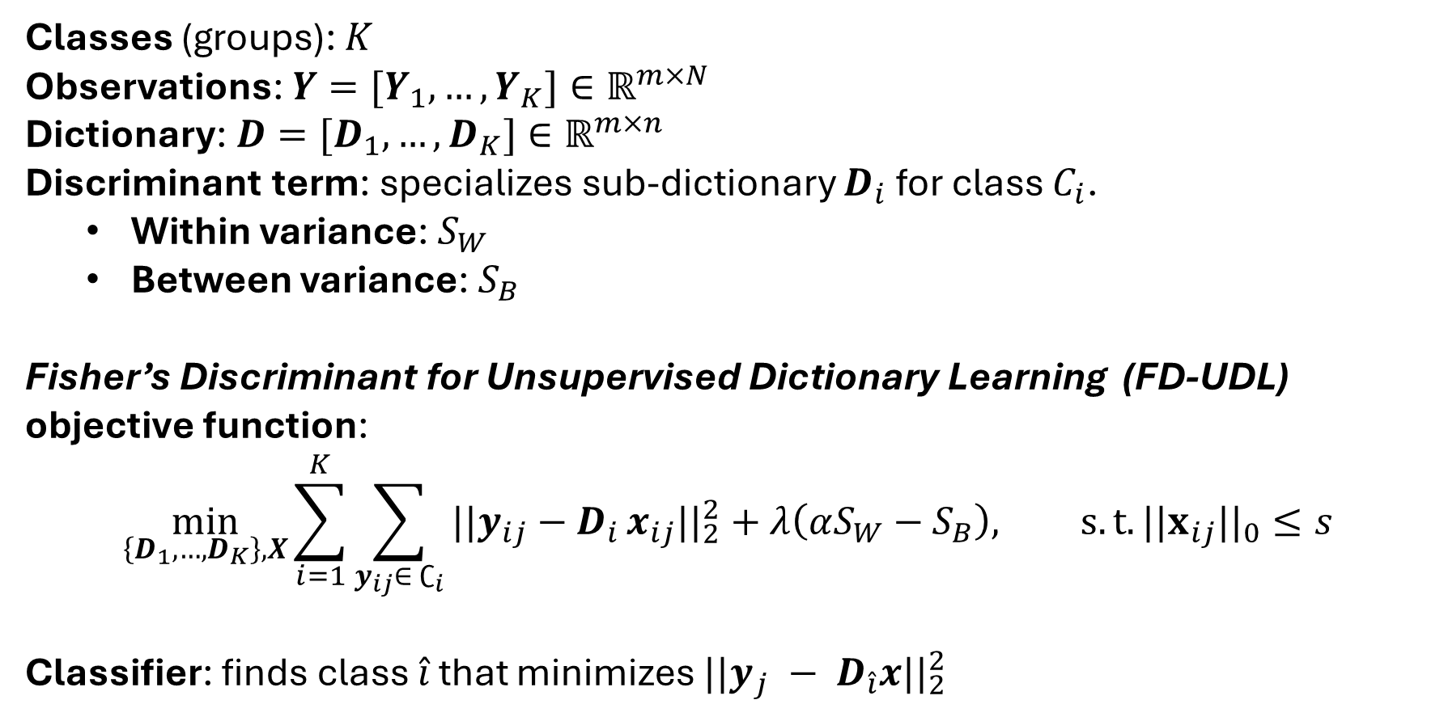
Classification: FD-UDL algorithm
Classes (groups): $K$
Observations: $Y=[Y_{1},…,Y_{K}]∈ℝ^{m×N}$
Dictionary: $D=[D_{1},…,D_{K}]∈ℝ^{m×n}$
Discriminant term: specializes sub-dictionary $D_{i}$ for class $C_{i}$.
Within variance: $S_{W}$
Between variance: $S_{B}$
Fisher’s Discriminant for Unsupervised Dictionary Learning (FD-UDL) objective function:
$$\min_{\left\{D_{1}, …,D_{K}\right\}, X}{\sum_{i=1}^{K}{\sum_{y_{ij}∈ ∁_{i}}{||y_{ij}−D_{i}}x_{ij}{||}_{2}^{2}}}+λ\left(αS_{W}−S_{B}\right), s.t. ||x_{ij}{||}_{0}≤s$$
Classifier: finds class $\hat{i}$ that minimizes $||y_{j} − D_{\hat{i}}x{||}_{2}^{2}$

Slide 6
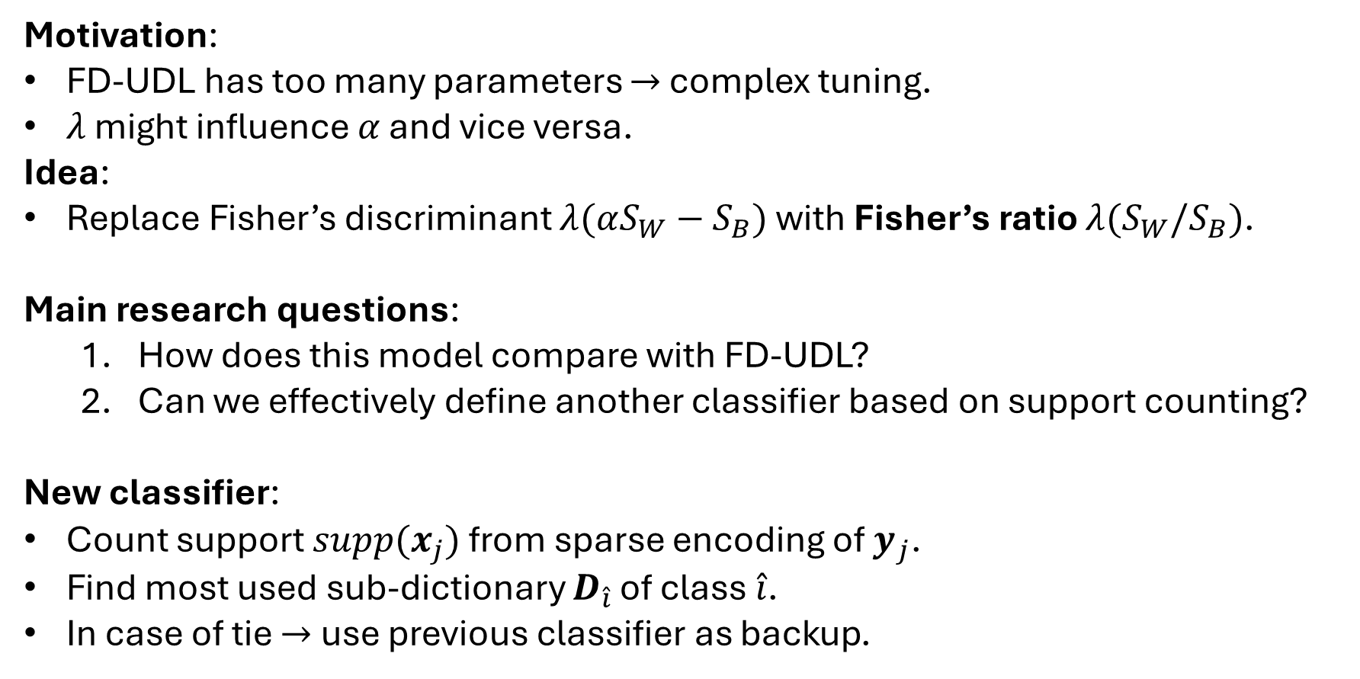
Novel model
Motivation:
FD-UDL has too many parameters $→$ complex tuning.
$λ$ might influence $α$ and vice versa.
Idea:
Replace Fisher’s discriminant $λ(αS_{W}−S_{B})$ with Fisher’s ratio $λ(S_{W}/S_{B})$.
Main research questions:
How does this model compare with FD-UDL?
Can we effectively define another classifier based on support counting?
New classifier:
Count support $supp(x_{j})$ from sparse encoding of $y_{j}$.
Find most used sub-dictionary $D_{\hat{i}}$ of class $\hat{i}$.
In case of tie $→$ use previous classifier as backup.

Slide 7
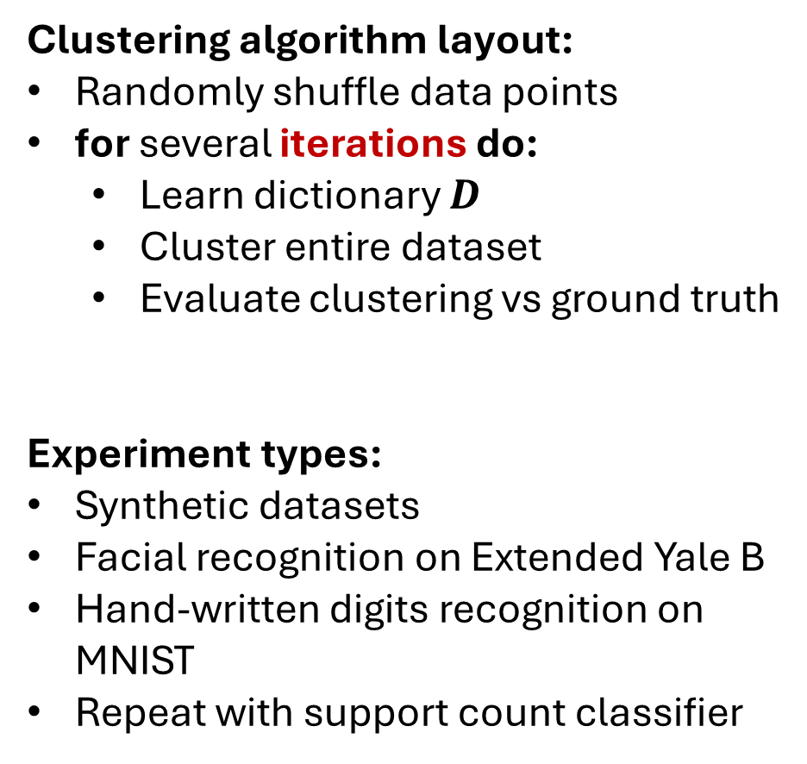
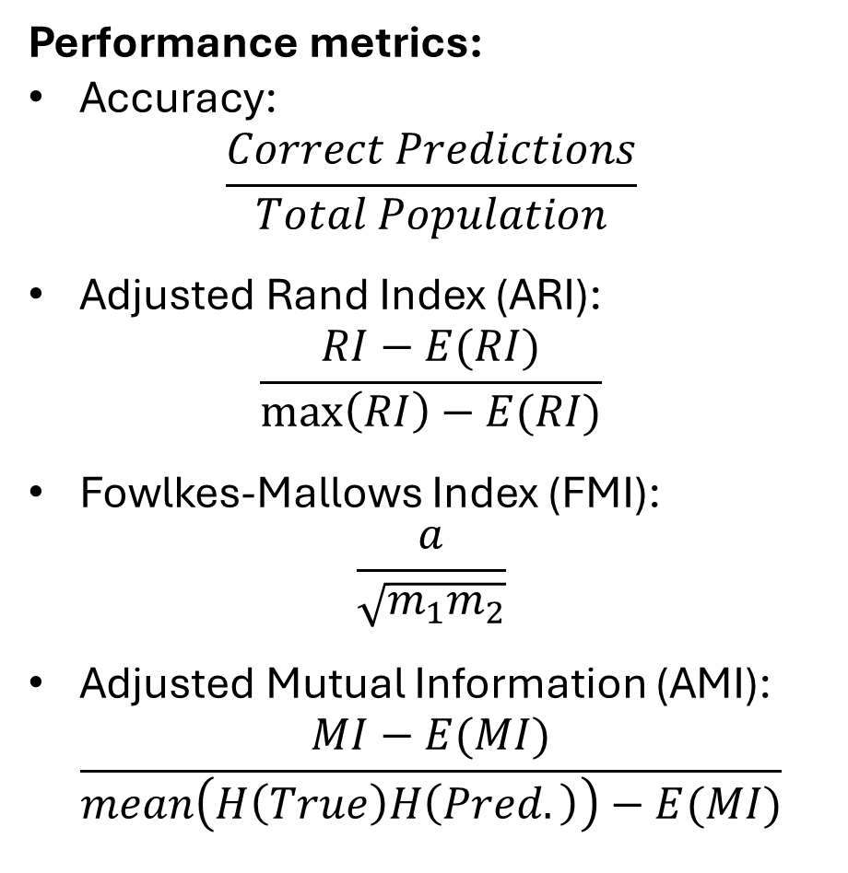
Assessment of novel model
Clustering algorithm layout:
Randomly shuffle data points
for several iterations do:
Learn dictionary $D$
Cluster entire dataset
Evaluate clustering vs ground truth
Experiment types:
Synthetic datasets
Facial recognition on Extended Yale B
Hand-written digits recognition on MNIST
Repeat with support count classifier
Performance metrics:
Accuracy:
$$\frac{Correct Predictions}{Total Population}$$
Adjusted Rand Index (ARI):
$$\frac{RI−E(RI)}{\max\left(RI\right)−E(RI)}$$
Fowlkes-Mallows Index (FMI):
$$\frac{a}{\sqrt{m_{1}m_{2}}}$$
Adjusted Mutual Information (AMI):
$$\frac{MI−E(MI)}{mean\left(H\left(True\right)H\left(Pred.\right)\right)−E(MI)}$$
7

Slide 8
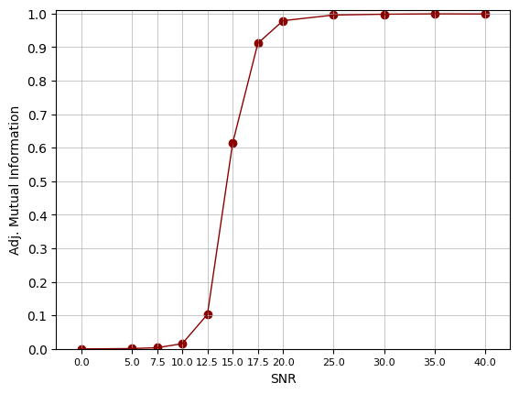
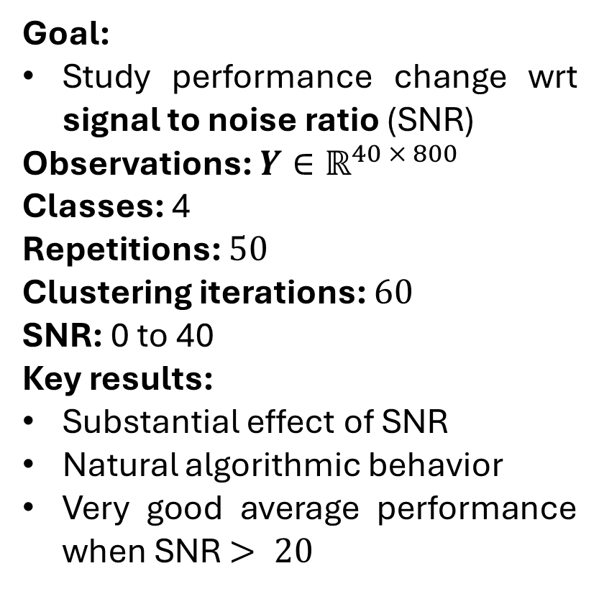
Synthetic data clustering
Goal:
Study performance change wrt signal to noise ratio (SNR)
Observations: $Y∈ℝ^{40 × 800}$
Classes: 4
Repetitions: $50$
Clustering iterations: $60$
SNR: 0 to 40
Key results:
Substantial effect of SNR
Natural algorithmic behavior
Very good average performance when SNR $> 20$
Fig. 1: Average AMI with changing SNR.

Slide 9
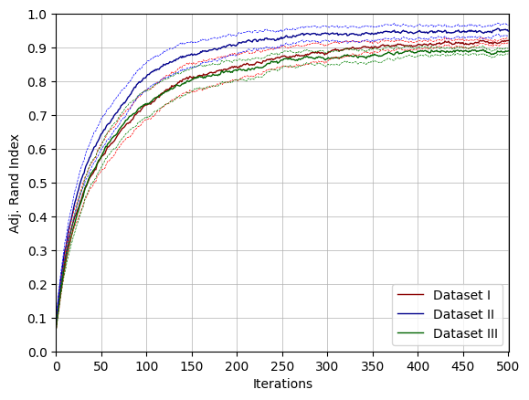
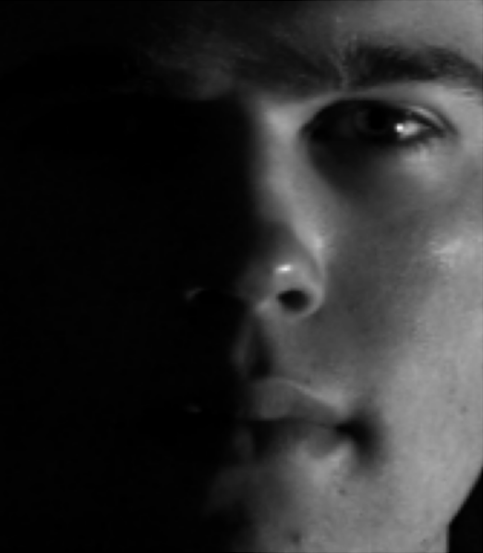
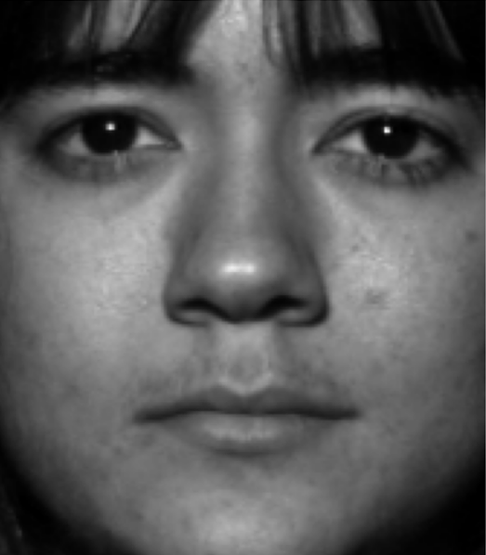
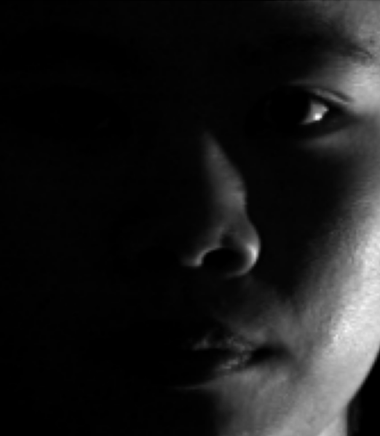
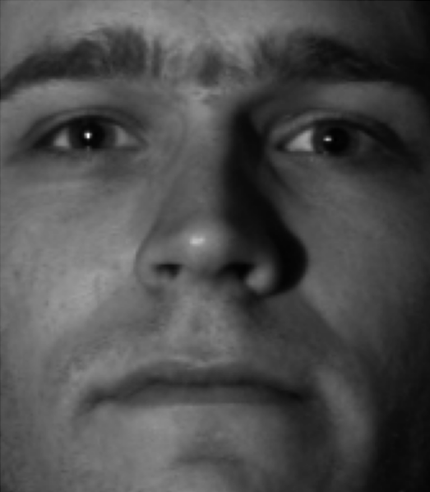
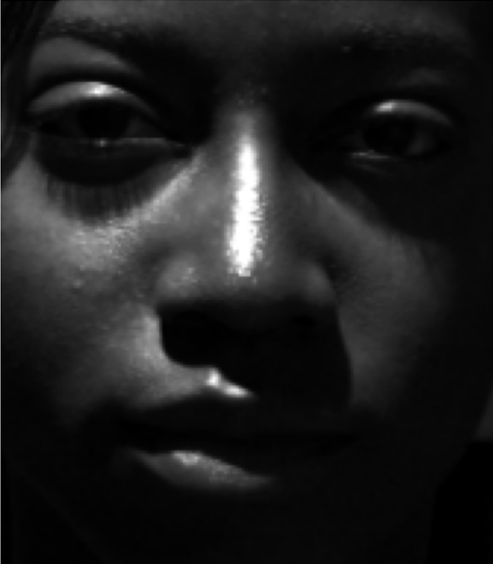
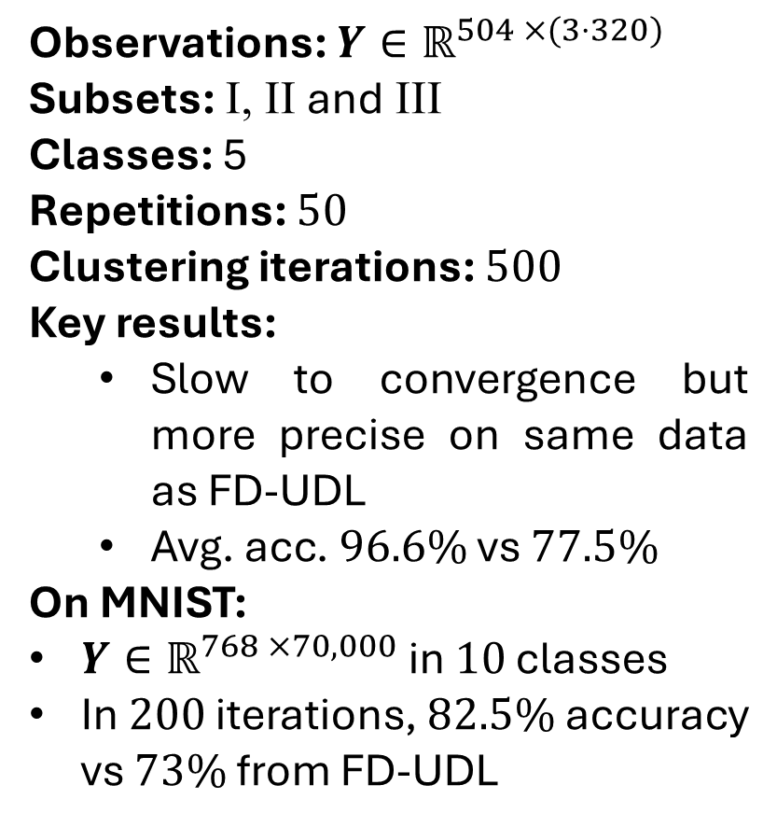
Image recognition
Observations: $Y∈ℝ^{504 ×(3⋅320)}$
Subsets: I, II and III
Classes: 5
Repetitions: $50$
Clustering iterations: $500$
Key results:
Slow to convergence but more precise on same data as FD-UDL
Avg. acc. $96.6\%$ vs $77.5\%$
On MNIST:
$Y∈ℝ^{768 ×70,000}$ in $10$ classes
In $200$ iterations, $82.5\%$ accuracy vs $73\%$ from FD-UDL
Fig. 2: Average ARI on three Ext. Yale B subsets.

Slide 10
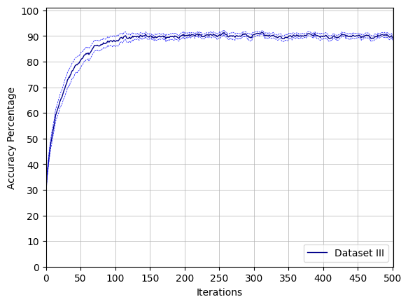
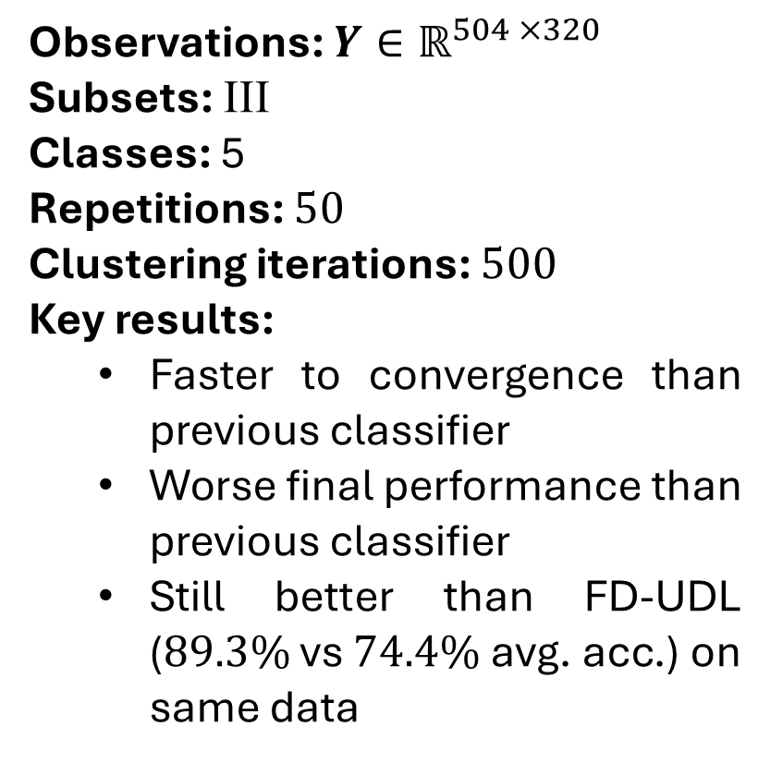
Support count classification
Observations: $Y∈ℝ^{504 ×320}$
Subsets: III
Classes: 5
Repetitions: $50$
Clustering iterations: $500$
Key results:
Faster to convergence than previous classifier
Worse final performance than previous classifier
Still better than FD-UDL ($89.3\%$vs $74.4\%$ avg. acc.) on same data
Fig. 3: Average accuracy on Ext. Yale B subset III.

Slide 11
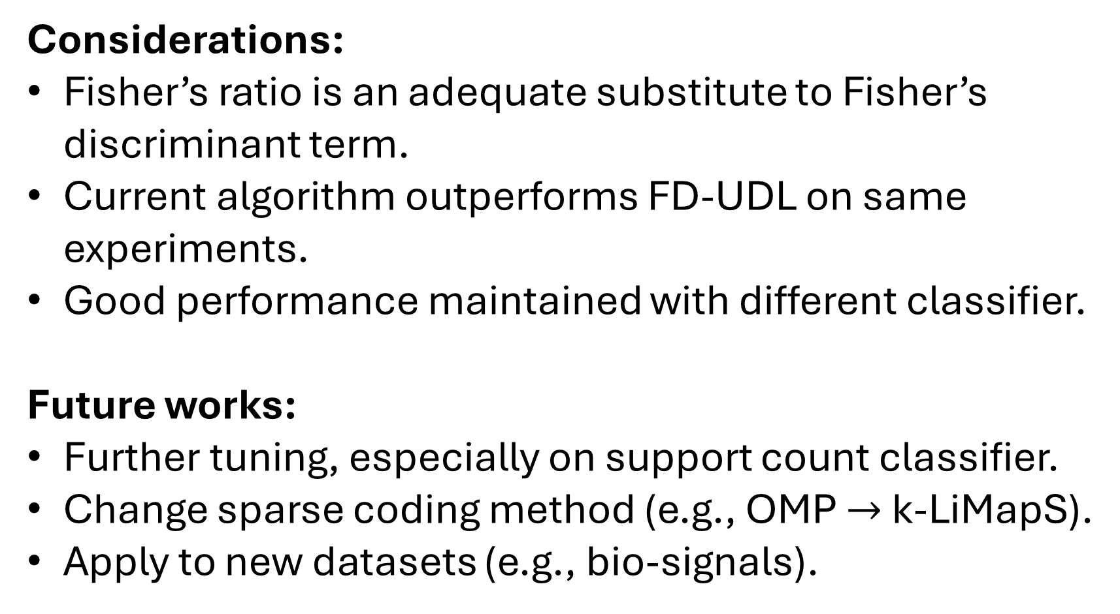
Conclusions
Considerations:
Fisher’s ratio is an adequate substitute to Fisher’s discriminant term.
Current algorithm outperforms FD-UDL on same experiments.
Good performance maintained with different classifier.
Future works:
Further tuning, especially on support count classifier.
Change sparse coding method (e.g., OMP $→$ k-LiMapS).
Apply to new datasets (e.g., bio-signals).

Slide 12
Thank you for your attention!

Slide 13
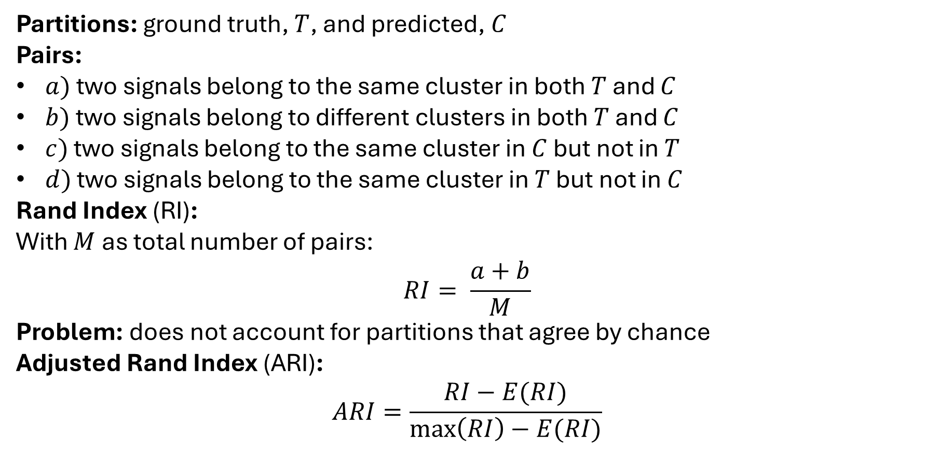
Additional Information, ARI
Partitions: ground truth, $T$, and predicted, $C$
Pairs:
$a)$ two signals belong to the same cluster in both $T$ and $C$
$b)$ two signals belong to different clusters in both $T$ and $C$
$c)$ two signals belong to the same cluster in $C$ but not in $T$
$d)$ two signals belong to the same cluster in $T$ but not in $C$
Rand Index (RI):
With $M$ as total number of pairs:
$$RI= \frac{a+b}{M}$$
Problem: does not account for partitions that agree by chance
Adjusted Rand Index (ARI):
$$ARI=\frac{RI−E(RI)}{\max\left(RI\right)−E(RI)}$$
13

Slide 14
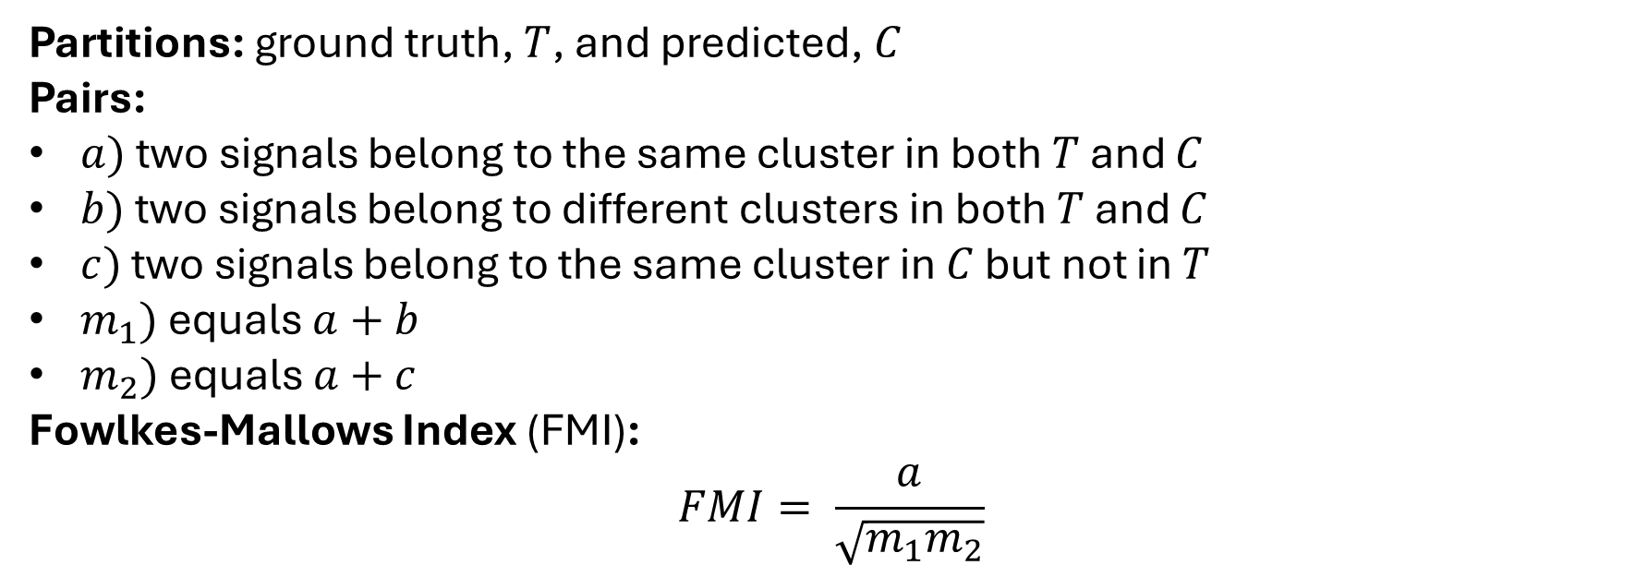
Additional Information, FMI
Partitions: ground truth, $T$, and predicted, $C$
Pairs:
$a)$ two signals belong to the same cluster in both $T$ and $C$
$b)$ two signals belong to different clusters in both $T$ and $C$
$c)$ two signals belong to the same cluster in $C$ but not in $T$
$m_{1})$ equals $a+b$
$m_{2})$ equals $a+c$
Fowlkes-Mallows Index (FMI):
$$FMI= \frac{a}{\sqrt{m_{1}m_{2}}}$$

Slide 15
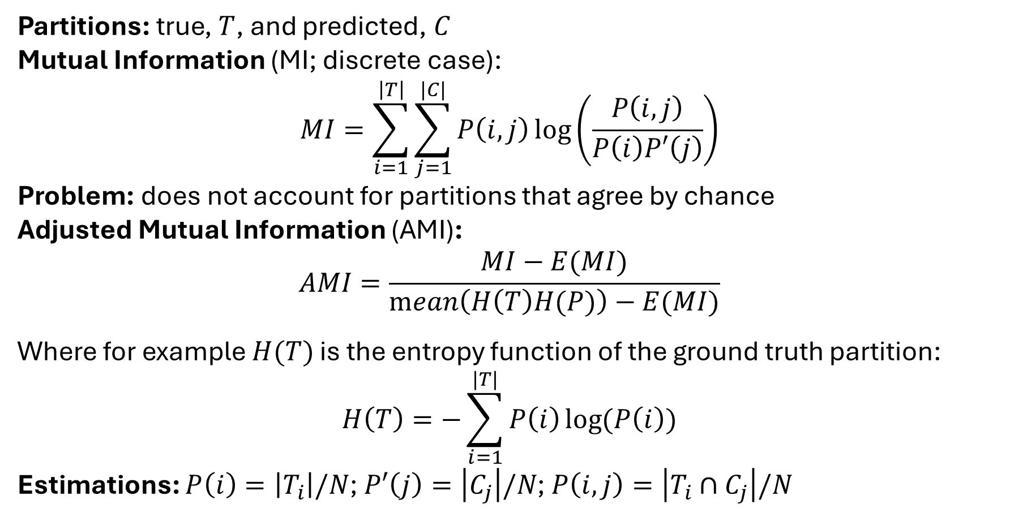
Additional Information, AMI
Partitions: true, $T$, and predicted, $C$
Mutual Information (MI; discrete case):
$$MI=\sum_{i=1}^{\left|T\right|}{\sum_{j=1}^{|C|}{P\left(i,j\right)\log\left(\frac{P\left(i,j\right)}{P\left(i\right)P′\left(j\right)}\right)}}$$
Problem: does not account for partitions that agree by chance
Adjusted Mutual Information (AMI):
$$AMI=\frac{MI−E(MI)}{\operatorname{mean}\left(H\left(T\right)H(P)\right)−E(MI)}$$
Where for example $H(T)$ is the entropy function of the ground truth partition:
$$H\left(T\right)=−\sum_{i=1}^{|T|}{P\left(i\right)\log{(P\left(i\right))}}$$
Estimations: $P\left(i\right)=\left|T_{i}\right|/N$;$P′\left(j\right)=\left|C_{j}\right|/N$; $P\left(i, j\right)=\left|T_{i}∩C_{j}\right|/N$
15

Slide 16
Additional Information, SNR experiment
Parameter name | Clustering iter. | DL iter. | DU epochs | $$λ$$ | Adam l. r.
Value | $$60$$ | $$10$$ | $$10$$ | $$0.1$$ | $$0.1$$
Tab. 1. Parameters for SNR experiment on synthetic data.
SNR | Accuracy % | Rand Idx. | Adj. RI | Adj. MI | F-M Idx. | AMI std.
0 | 28.009 | 0.625 | 0.000 | 0.000 | 0.2495 | 0.165
5 | 28.493 | 0.626 | 0.001 | 0.001 | 0.2503 | 0.216
7.5 | 29.202 | 0.626 | 0.003 | 0.003 | 0.252 | 0.379
10 | 32.450 | 0.631 | 0.014 | 0.015 | 0.261 | 0.904
12.5 | 43.695 | 0.661 | 0.096 | 0.103 | 0.322 | 3.622
15 | 84.042 | 0.871 | 0.655 | 0.614 | 0.741 | 11.193
17.5 | 97.515 | 0.976 | 0.937 | 0.911 | 0.953 | 5.059
20 | 99.492 | 0.995 | 0.987 | 0.979 | 0.990 | 1.407
30 | 99.955 | 1.000 | 0.999 | 0.998 | 0.999 | 0.211
40 | 99.970 | 1.000 | 0.999 | 0.999 | 0.999 | 0.278
Tab. 2. SNR experiment results.
16

Slide 17
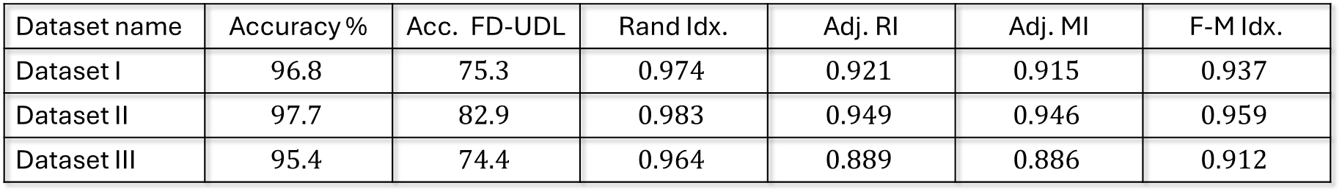
Additional Information, image recognition
Parameter name | Clustering iter. | DL iter. | DU epochs | $$λ$$ | Adam l. r.
Value | $$500$$ | $$1$$ | $$80$$ | $$0.1$$ | $$0.1$$
Tab. 3. Parameters for facial recognition on Yale B.
Dataset name | Accuracy % | Acc. FD-UDL | Rand Idx. | Adj. RI | Adj. MI | F-M Idx.
Dataset I | $$96.8$$ | $$75.3$$ | $$0.974$$ | $$0.921$$ | $$0.915$$ | $$0.937$$
Dataset II | $$97.7$$ | $$82.9$$ | $$0.983$$ | $$0.949$$ | $$0.946$$ | $$0.959$$
Dataset III | $$95.4$$ | $$74.4$$ | $$0.964$$ | $$0.889$$ | $$0.886$$ | $$0.912$$
Tab. 4. Facial recognition on Yale B results.
Parameter name | Clustering iter. | DL iter. | DU epochs | $$λ$$ | Adam l. r.
Value | $$200$$ | $$5$$ | $$160$$ | $$0.1$$ | $$0.1$$
Dataset name | Accuracy % | Acc. FD-UDL | Rand Idx. | Adj. RI | Adj. MI | F-M Idx.
MNIST | $$82.5$$ | $$73.0$$ | $$0.9451$$ | $$0.7001$$ | $$0.7644$$ | $$0.7307$$
Tab. 5/6. Parameters and results for hand-written digits recognition on MNIST.

Slide 18
Additional Information, new classifier
Parameter name | Clustering iter. | DL iter. | DU epochs | $$λ$$ | Adam l. r.
Value | $$500$$ | $$1$$ | $$80$$ | $$0.1$$ | $$0.004$$
Tab. 7. Parameters for facial recognition on Yale B with new classifier.
Dataset name | Accuracy % | Acc. FD-UDL | Rand Idx. | Adj. RI | Adj. MI | F-M Idx.
Dataset III | $$89.3$$ | $$74.4$$ | $$0.921$$ | $$0.751$$ | $$0.741$$ | $$0.801$$
Tab. 8. Results for facial recognition on Yale B with new classifier.

